Slide 1
Does Corporate Diversification Destroy Value?
John R. Graham
Duke University
Michael L. Lemmon
University of Utah
Jack Wolf
University of Utah
Presenter : 周立軒

Slide 2
Agenda
Intuition
Literature Review
Data & Experiment & Result
Conclusion

Slide 3
Intuition
Since 1990s, more and more paper discuss about “Diversification will destroy value” .
According to the standard methodologies, diversified firms with valuation discounts had aggregate value losses of over $800 billion in 1995.
Berger and Ofek (1995) find that U.S. conglomerates are priced at approximately a 15% discount on average.

Slide 4
Intuition
To evaluate whether corporate diversification destroys value, the ideal experiment would be
Sum the market values of each separate division, and then compare this sum to the actual market value of the conglomerate.
But it’s impossible since the divisions of conglomerate are not public traded

Slide 5
Intuition
The usual approach is
Benchmark the conglomerate divisions to the value of the median stand-alone firm that operates in the same industry.
What if this methodology can lead a systematically bias?

Slide 6
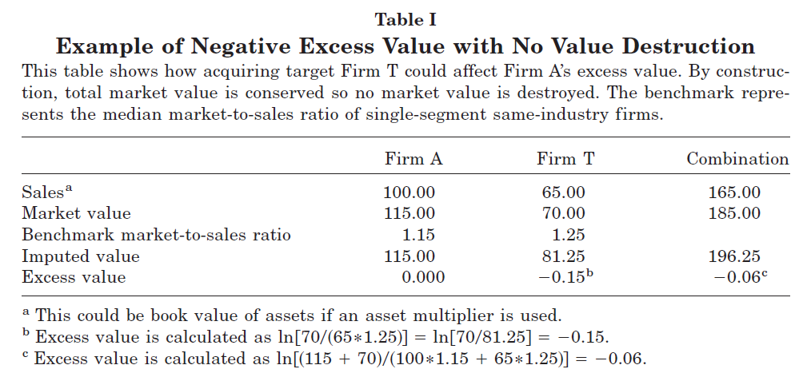
Intuition

Slide 7
Intuition
This paper propose another approach:
Observe the market value of the acquired and acquiring firms directly before they become conglomerate .
Then, evaluate the “Excess Value” for both, and compare the difference of the Surviving Company between ”Before” and “After”.
Besides, for company is single-segment originally, and become multi-segment by M&A or inner growth, the excess value is compared, too.

Slide 8
Literature Review
Lang and Stulz (1994)
Find that multi-segment firms appear to be priced at a substantial discount relative to a portfolio of single-segment firms.
Berger and Ofek (1995)
Find that U.S. conglomerates are priced at approximately a 15% discount on average.

Slide 9
Literature Review
Lamont and Polk (1999)
Provide evidence that conglomerate firms have higher required returns and that this can account for approximately one-third of the empirically observed diversification discount.
Anderson et al. (1999)
Find that diversified firms have more outside directors and that outside directors are positively associated with excess values in diversified firms.

Slide 10
Data & Experiment & Result
Data
Select from Compustat and SDC
Exclude financial companies
Use SIC code for distinguishing the unrelated and related M&A.
Excess Value
ln[Actual Value/ Imputed Value] (By Berger and Ofek (1995))

Slide 11
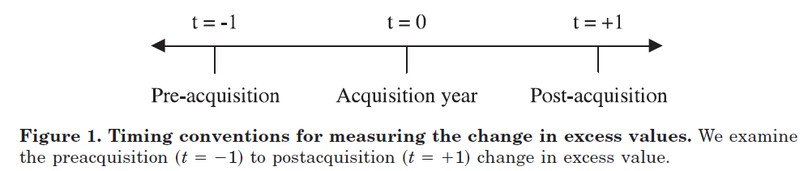
Data & Experiment & Result
Timing

Slide 12
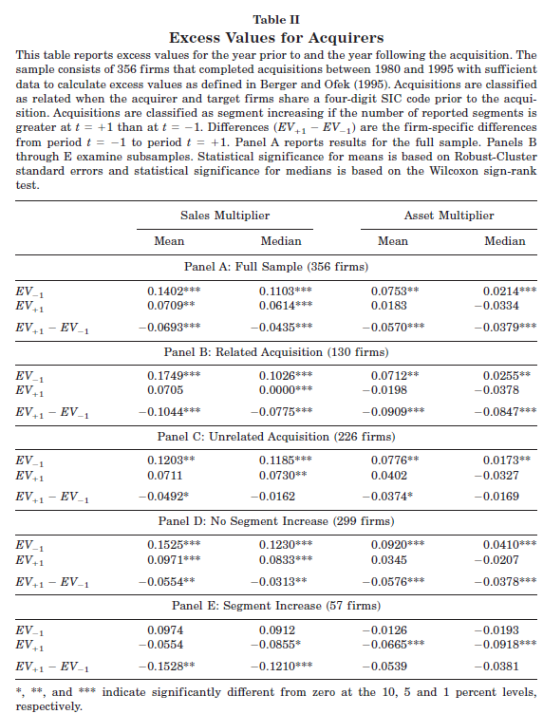
Data & Experiment & Result

Slide 13
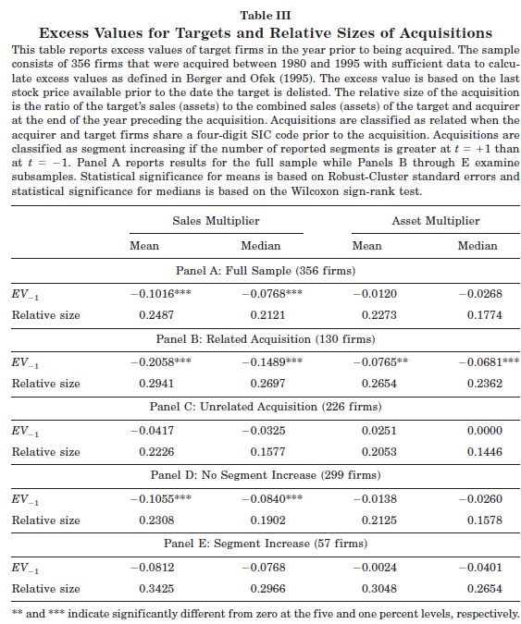
Data & Experiment & Result

Slide 14

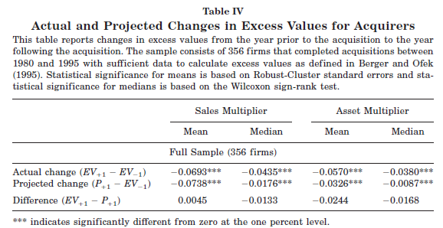
Data & Experiment & Result

Slide 15
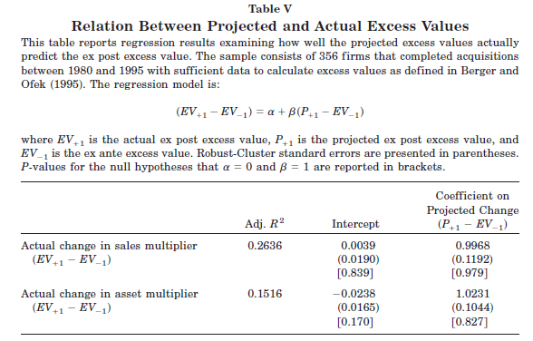
Data & Experiment & Result

Slide 16
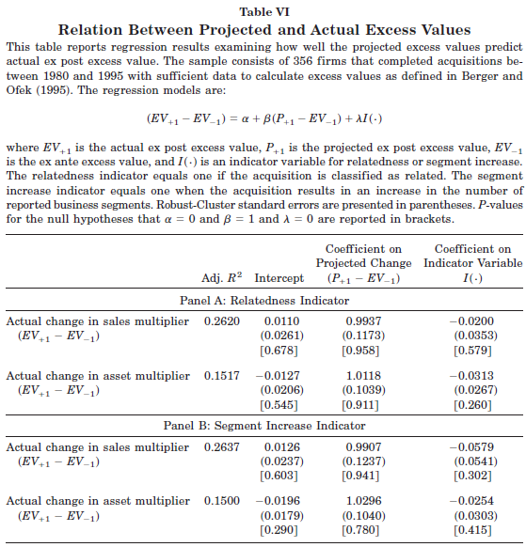
Data & Experiment & Result

Slide 17
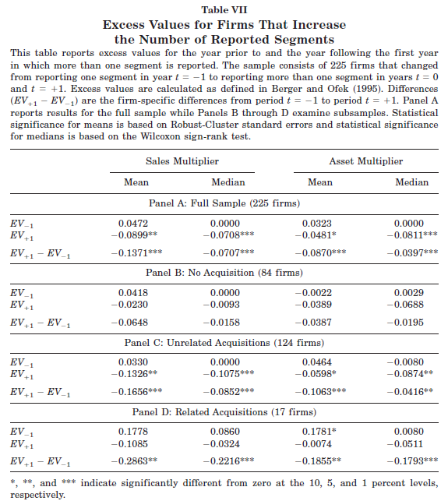
Data & Experiment & Result

Slide 18
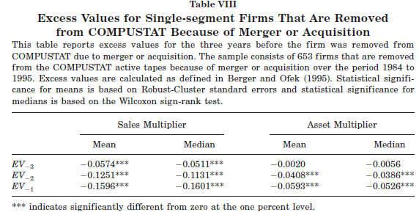
Data & Experiment & Result

Slide 19
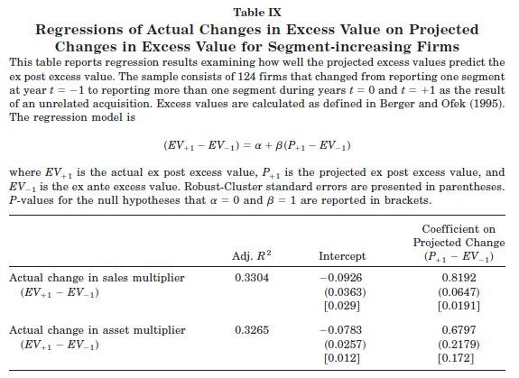
Data & Experiment & Result

Slide 20
Conclusion
Three Points:
1. Using stand-alone firm approach for conglomerate divisions can lead some bias
2. The Target Firm is usually “Discounted” before M&A is one of important cause for value destroying. M&A itself doesn’t result to value loss.
3. Segment increasing by acquiring loss more value than internal growth, and these reported loss value more than these not reported

